Slide 1
DSC530 Final Project Visits to all domains over 30 days Comparison Date Pulled: 4/5/2020 and 5/17/2020
Source: https://analytics.usa.gov/data/
Rachel Young
5/23/2020

Slide 2
Introduction
The datasets I used are from the analytics.usa.gov website
I pulled the data from the “Visits to all domains over 30 days” on 4/5/20 (3/6/20 through 4/420) and 5/17/20 (4/17/20 through 5/16/20)
The data comes from about 400 participating U.S. federal government agencies
There are about 5,700 total websites the website tracks analytical data for
When the first dataset was pulled COVID-19 was new and states started requiring stay at home orders
The COVID-19 Stimulus bill was passed (i.e. stimulus checks, aid for small businesses)
By the time the second dataset was pulled, there was a lot more COVID-19 research going on and people were adapting to all the economic unknowns
Source: https://analytics.usa.gov/data/

Slide 3
Statistical Question / Hypothesis
Statistical Question: At the start of a national pandemic, will people search more federal government websites to try to find more information out more about COVID-19 and the stimulus bill than after a certain point when people start adapting to the economic unknowns?
Hypothesis: I believe people will want to find out more about health issues related to COVID-19, the stimulus bill (i.e. stimulus checks, aid for small businesses), and every day uses (i.e. USPS) at the beginning of the national pandemic than after a certain point of time.

Slide 4
Variables Used
(based on the 4/5/20 and 5/17/20 data pulls)
Domain: Government Website
pageviews_per_session1: Page Views Per a Session (Data Pull: 4/5/20)
pageviews_per_session2: Page Views Per a Session (Data Pull: 5/17/20)
avg_session_duration1: Average Session Duration (Data Pull: 4/5/20)
avg_session_duration2: Average Session Duration (Data Pull: 5/17/20)
VisitsDiff: Difference between the number of visits
UsersDiff: Difference between the number of users
PageviewsPerSessionDiff: Difference between the number of page views per a session
AvgSessionDurationDiff: Difference between the average session duration
ExitsDiff: Difference between the number of exits from the government websites

Slide 5
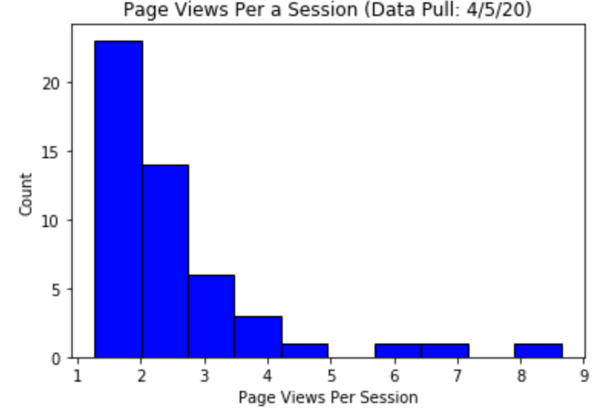
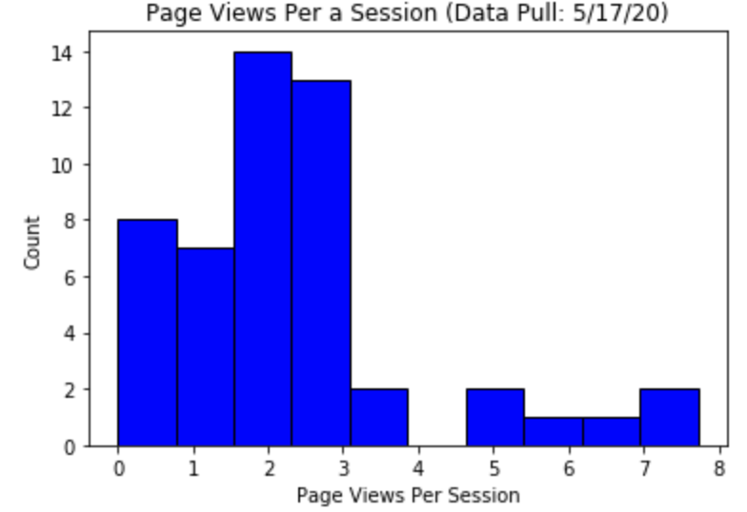
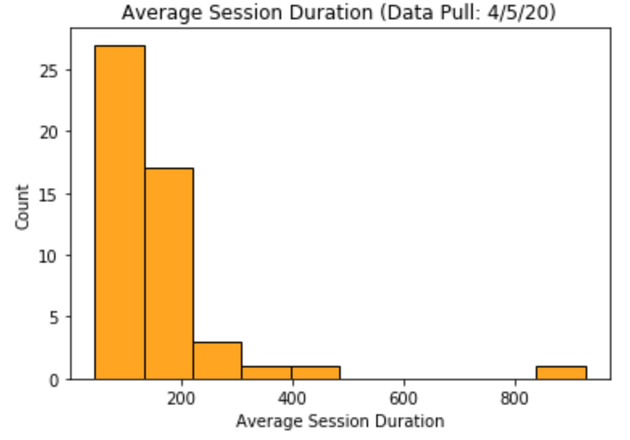
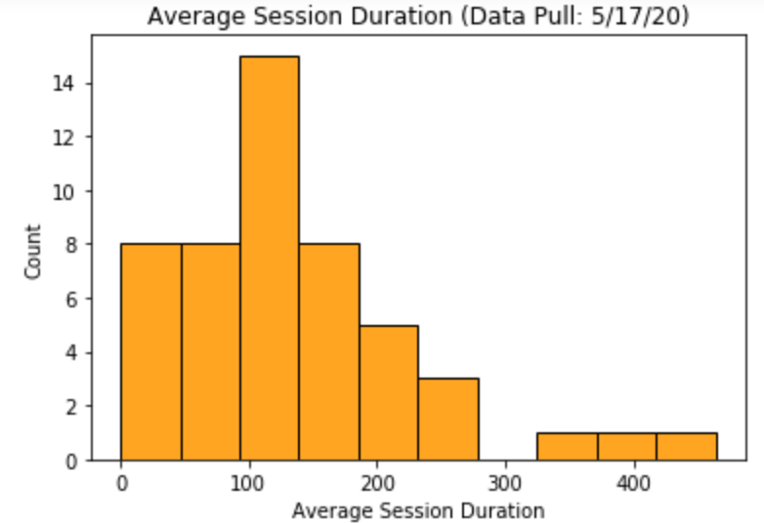
Histograms
(based on the 4/5/20 and 5/17/20 data pulls)

Slide 6
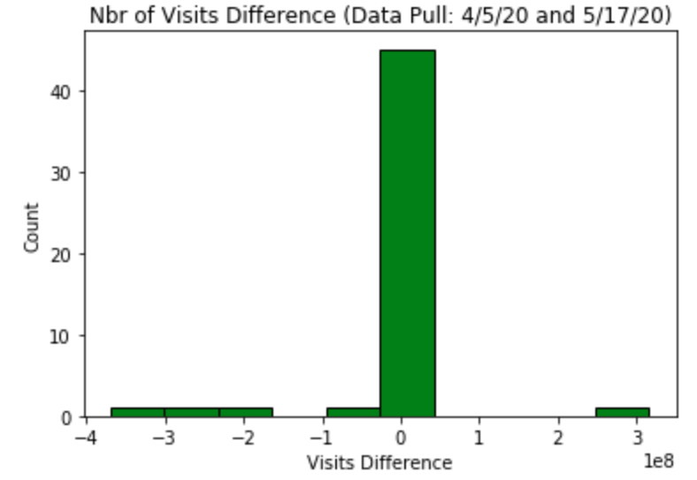
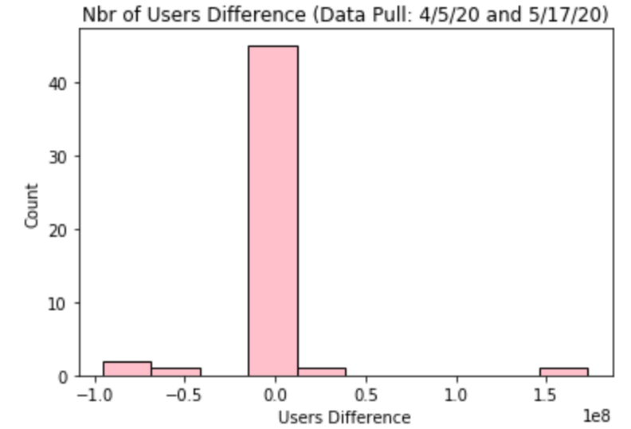
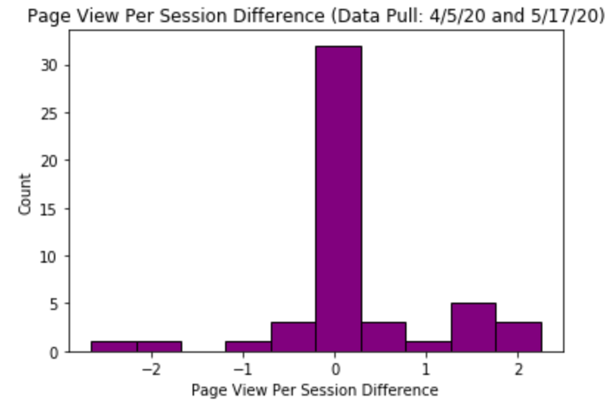
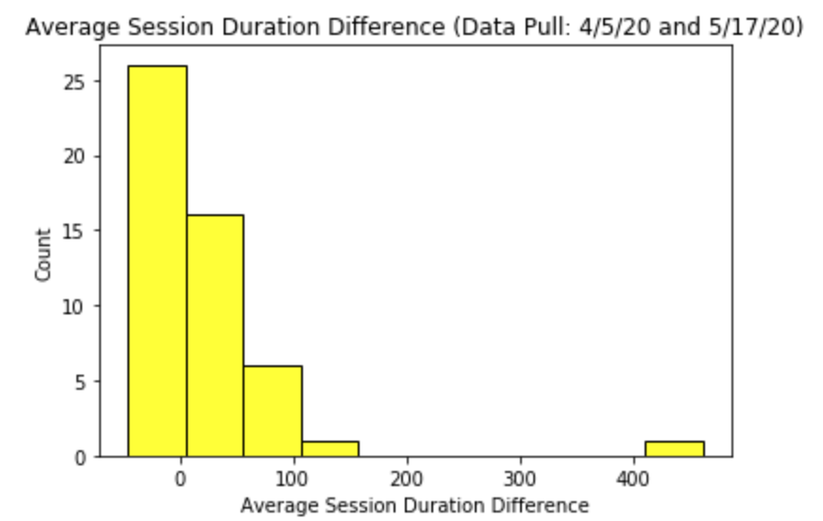
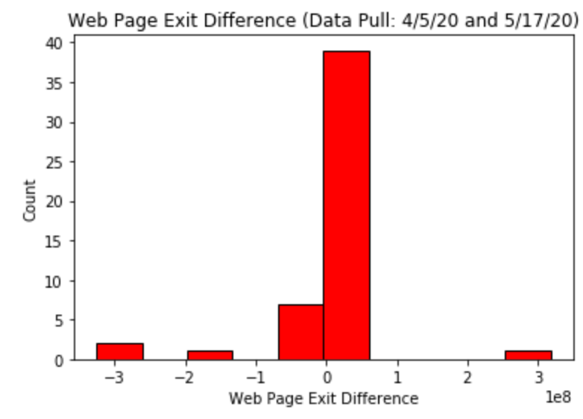
Histograms
(based on the 4/5/20 and 5/17/20 data pulls)

Slide 7
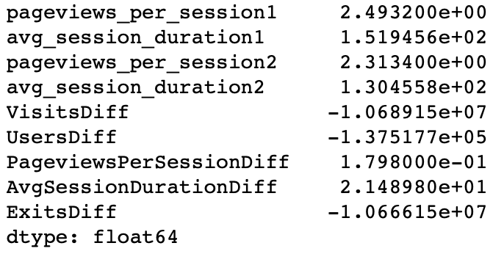

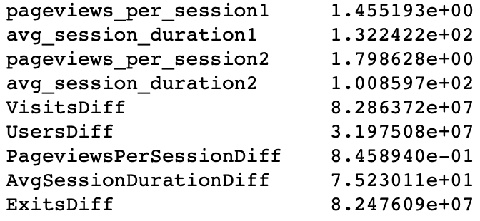
Descriptive Characteristics
(based on the 4/5/20 and 5/17/20 data pulls)
Mean
Variance
Standard Deviation

Slide 8
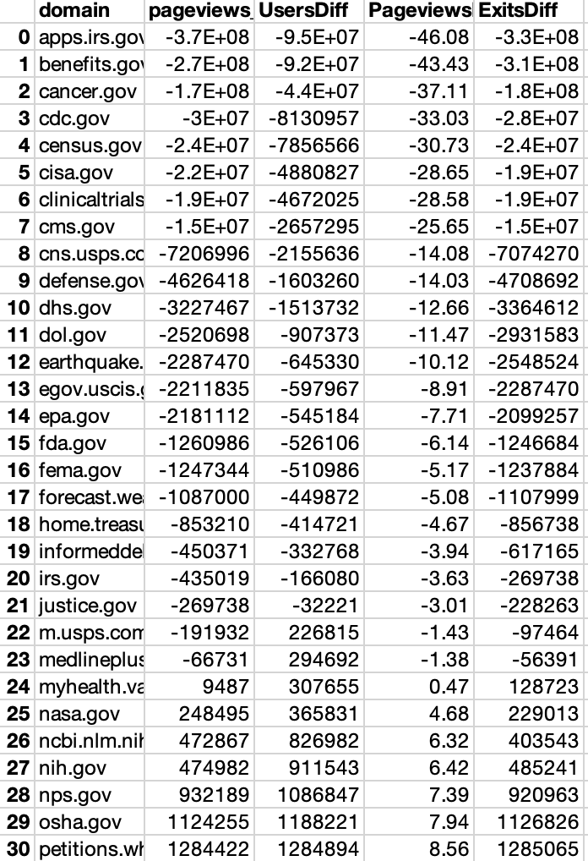
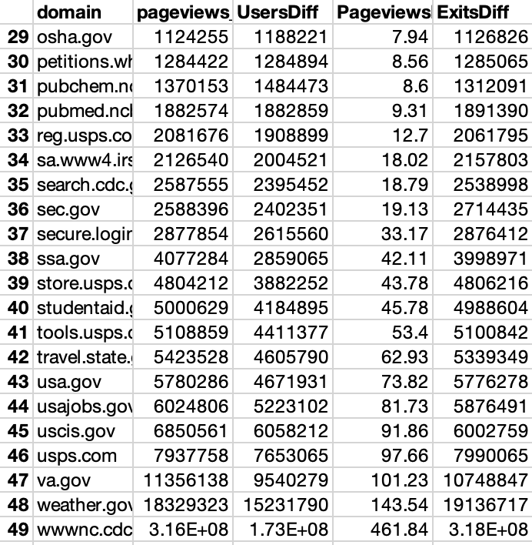
Descriptive Characteristics
(based on the 4/5/20 and 5/17/20 data pulls)
Mode

Slide 9
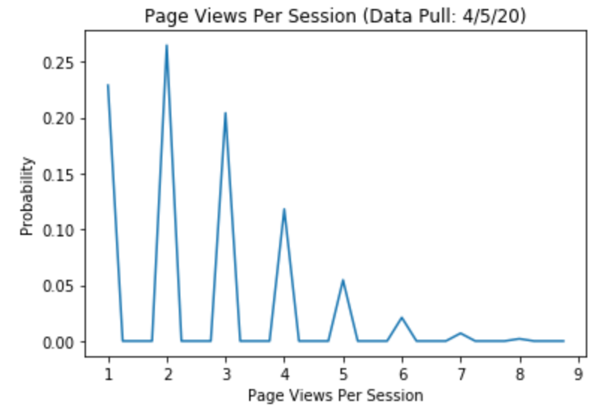
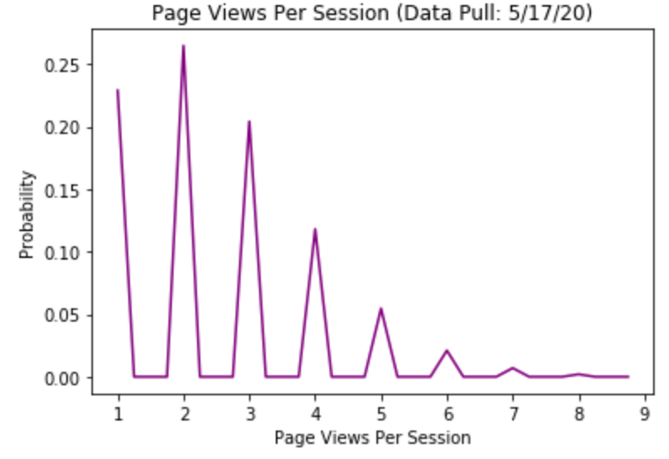
Probability Mass Function (PMF)
(based on the 4/5/20 and 5/17/20 data pulls)

Slide 10
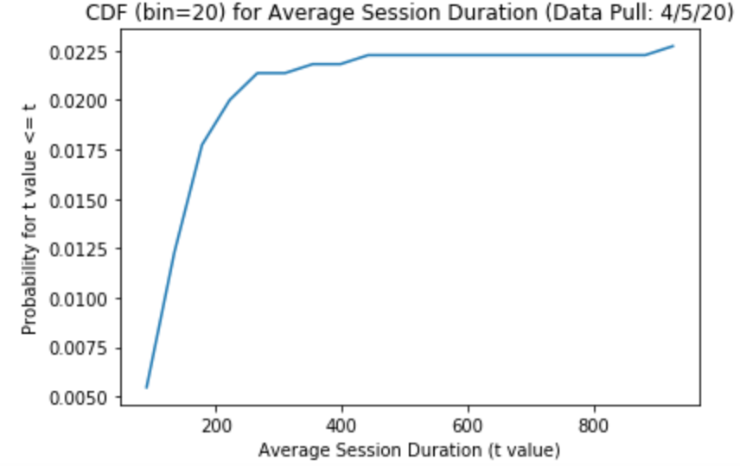
Cumulative Distribution Function (CDF)
(based on the 4/5/20 and 5/17/20 data pulls)

Slide 11
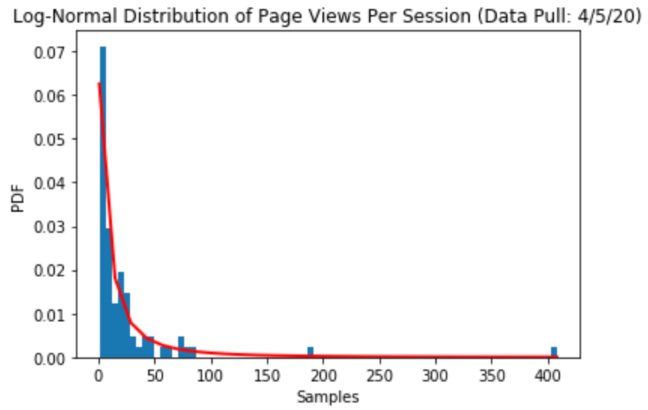
Analytical Distribution – Log-Normal
(based on the 4/5/20 and 5/17/20 data pulls)

Slide 12
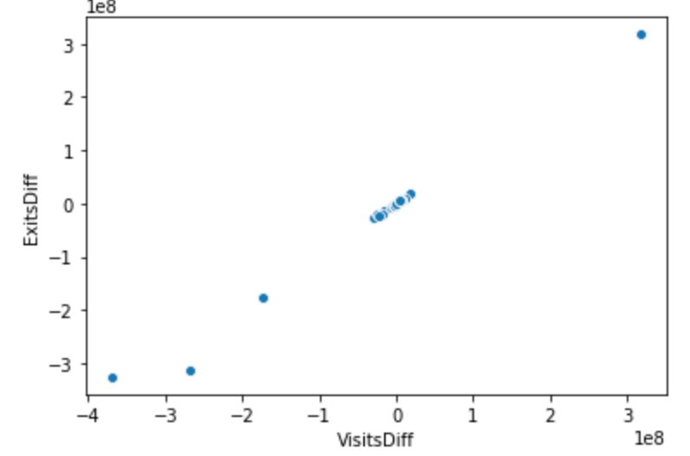
VisitsDiff and ExitsDiff Scatterplot
(based on the 4/5/20 and 5/17/20 data pulls)

Slide 13
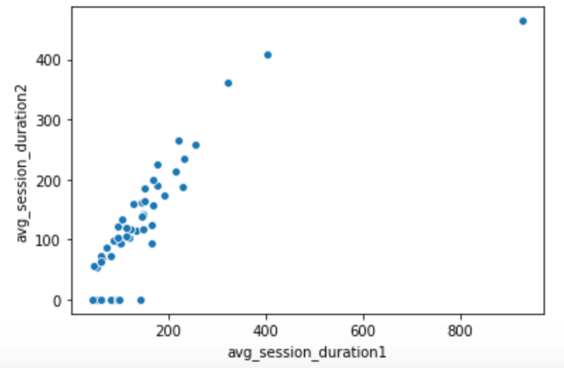
Avg_session_duration1 and Avg_sessionduration 2 Scatterplot
(based on the 4/5/20 and 5/17/20 data pulls)

Slide 14
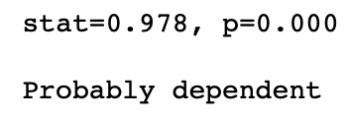
Hypothesis Test – Pearson Correlation
(based on the 4/5/20 and 5/17/20 data pulls)

Slide 15
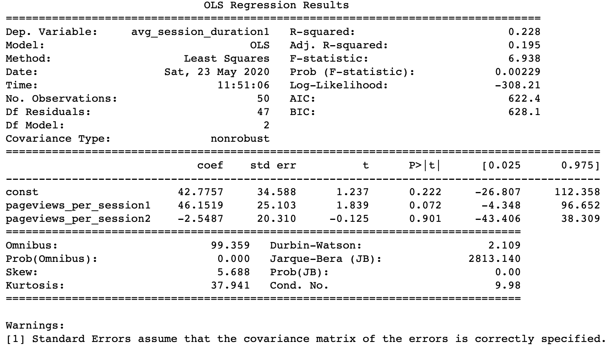
Multiple Linear Regression Analysis
(based on the 4/5/20 and 5/17/20 data pulls)

Slide 16
Summary
See summary for conclusion

